Slide 1
PROJECT Name: Customer Personality Analysis .
Problem Statement
Customer Personality Analysis is a detailed analysis of a company’s ideal customers. It helps a business to better understand its customers and makes it easier for them to modify products according to the specific needs, behaviours and concerns of different types of customers.
Customer personality analysis helps a business to modify its product based on its target customers from different types of customer segments. For example, instead of spending money to market a new product to every customer in the company’s database, a company can analyze which customer segment is most likely to buy the product and then market the product only on that particular segment.
Notes:
Problem Statement

Slide 2
Assignment Objective
The objectives for the problem statement of Customer Personality Analysis could include:
Customer Segmentation: To categorize customers into distinct segments based on their demographics, behaviors, and preferences.
Identify Ideal Customers: To pinpoint the most valuable and profitable customer segments for the business.
Customized Product Development: To tailor products or services to meet the specific needs and preferences of each customer segment.
Optimize Marketing Strategies: To develop targeted marketing campaigns that resonate with each customer segment, improving conversion rates and ROI.
Enhance Customer Satisfaction: To improve the overall customer experience by addressing the unique concerns of different customer groups.
Resource Allocation: To allocate marketing and operational resources more efficiently by focusing efforts on high-potential customer segments.
These objectives collectively aim to help businesses better understand, serve, and
retain their customers, ultimately driving growth and profitability.

Slide 3
Attributes
People
ID: Customer's unique identifier
Year_Birth: Customer's birth year
Education: Customer's education level
Marital_Status: Customer's marital status
Income: Customer's yearly household income
Kidhome: Number of children in customer's household
Teenhome: Number of teenagers in customer's household
Dt_Customer: Date of customer's enrollment with the company
Recency: Number of days since customer's last purchase
Complain: 1 if the customer complained in the last 2 years, 0 otherwise

Slide 4
Products
MntWines: Amount spent on wine in last 2 years
MntFruits: Amount spent on fruits in last 2 years
MntMeatProducts: Amount spent on meat in last 2 years
MntFishProducts: Amount spent on fish in last 2 years
MntSweetProducts: Amount spent on sweets in last 2 years
MntGoldProds: Amount spent on gold in last 2 years.
Promotion
NumDealsPurchases: Number of purchases made with a discount
AcceptedCmp1: 1 if customer accepted the offer in the 1st campaign, 0 otherwise
AcceptedCmp2: 1 if customer accepted the offer in the 2nd campaign, 0 otherwise
AcceptedCmp3: 1 if customer accepted the offer in the 3rd campaign, 0 otherwise

Slide 5
AcceptedCmp4: 1 if customer accepted the offer in the 4th campaign, 0 otherwise
AcceptedCmp5: 1 if customer accepted the offer in the 5th campaign, 0 otherwise
Response: 1 if customer accepted the offer in the last campaign, 0 otherwise
Place
NumWebPurchases: Number of purchases made through the company’s website
NumCatalogPurchases: Number of purchases made using a catalogue
NumStorePurchases: Number of purchases made directly in stores
NumWebVisitsMonth: Number of visits to company’s website in the last month

Slide 6
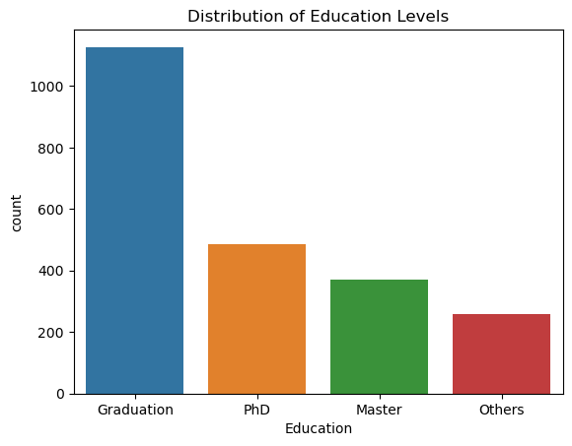
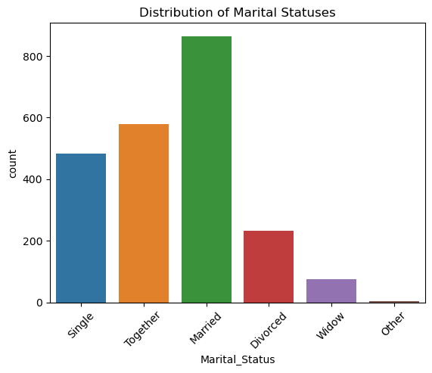
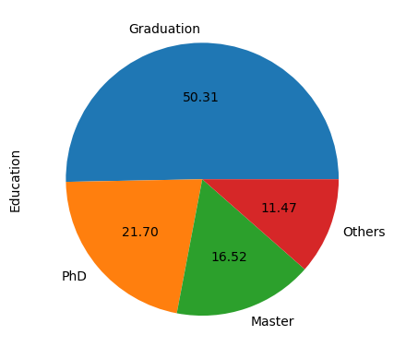
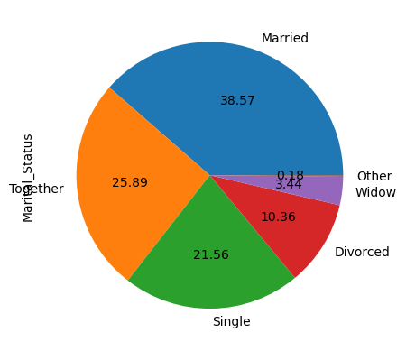
INSIGHTS FROM THE DATASET
Customers with Educational levels of Graduation and those who are married are highest in number. So these 2 segments could be targeted more.

Slide 7
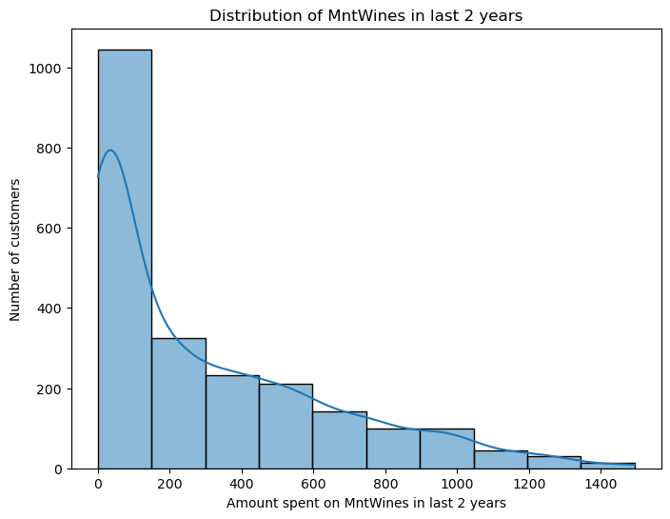
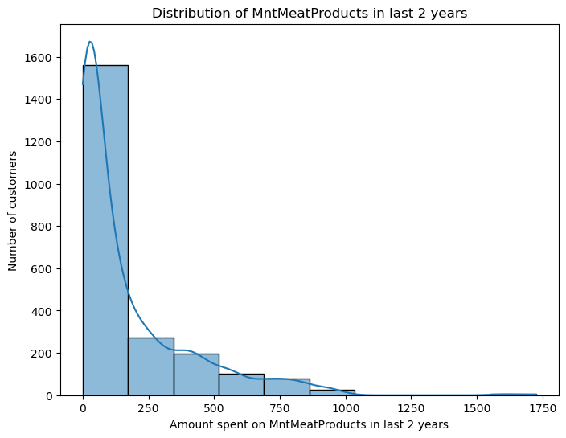
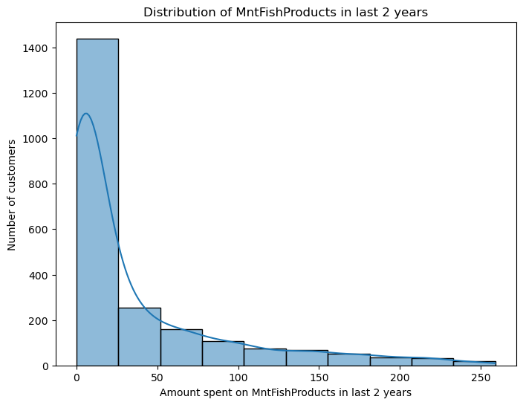
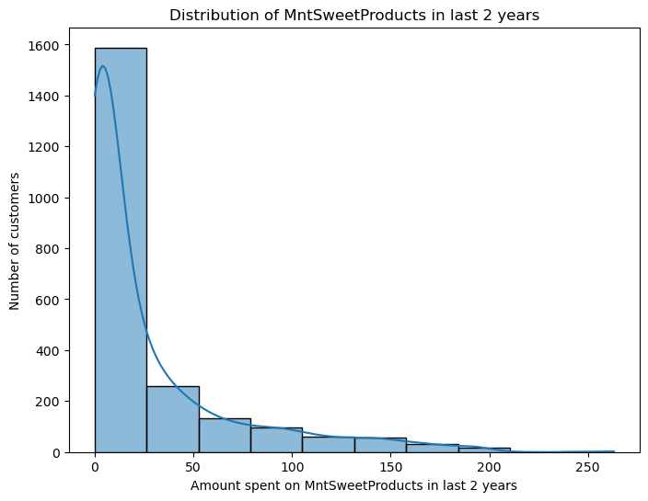

Slide 8
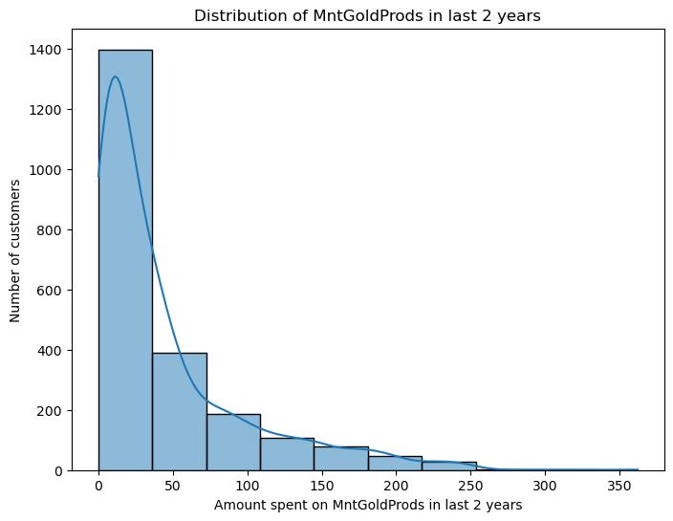
Majority of the customers are spending less than $200 (avg :303.935714) on wine. This shows that customers have their budget set for wines around $100/year, and they very rarely spent beyond that for wines.
Amount spent on meat in last 2 years by the customers is majorly less than $250, this amount is slightly higher than amount spent on wines. Which means customer more frequently eat meat products. Hence the availability of meat products must be constant at stores.
Amount spent on fish product in last 2 years by the customers is majorly less than $25, which quite less than meat. This shows majority of customer prefer meat over fish products.
Amount spent on sweet in last 2 years by the customers is majorly less than $25.
Amount spent on Gold in last 2 years by the customers is majorly less than $45, this is slightly higher than customer spending on fish and sweets products.

Slide 9
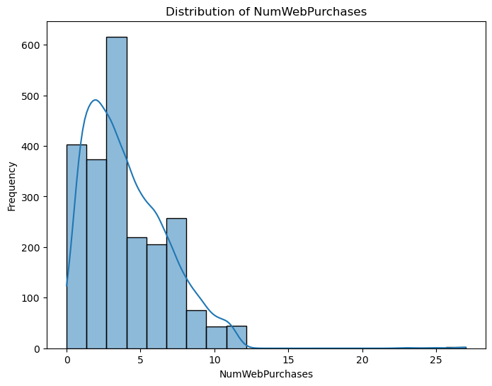
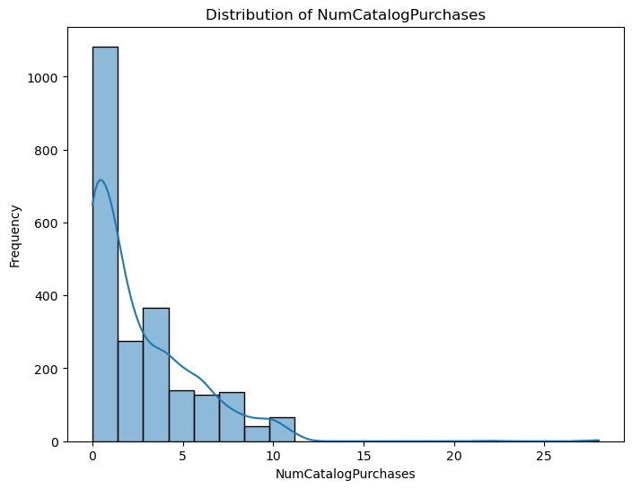
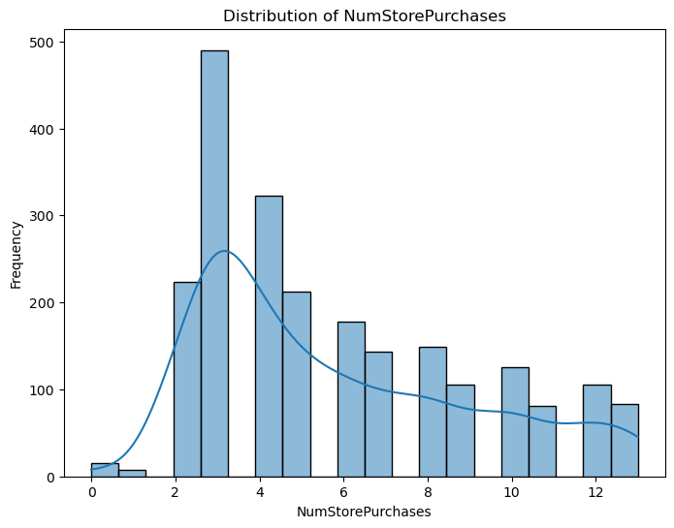
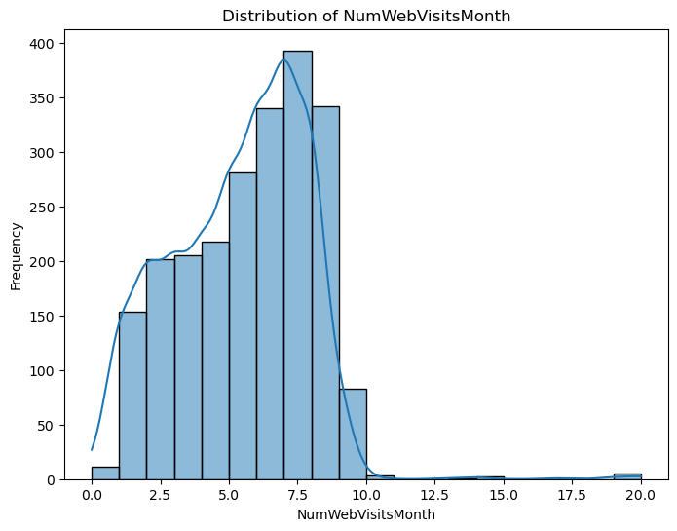

Slide 10
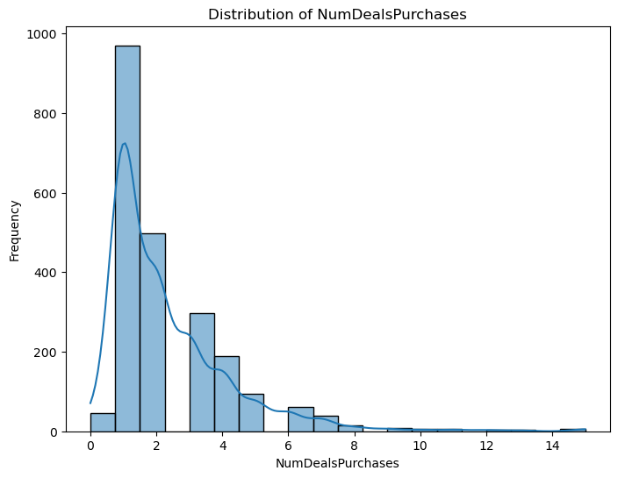
Number of purchases made through the company’s website on an average by the customer is around 4.
Number of purchases made using a catalogue is very less compared to other methods. . More than 1200 customers ,that is around half of the total number of customer, purchased only 1-2 times through catalog purchases.
Number of purchases made directly in stores by the customer is around 5 times on an average which is more than website based purchase.
Even though Customers like to purchase more from the stores, Still Number of visits to company’s website in the last month on an average is 6-7 times, shows that customer are now slowly inclining towards online purchase.

Slide 11
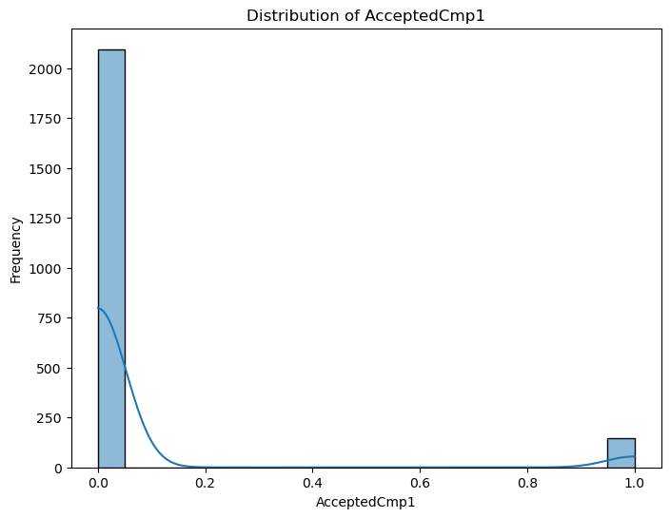
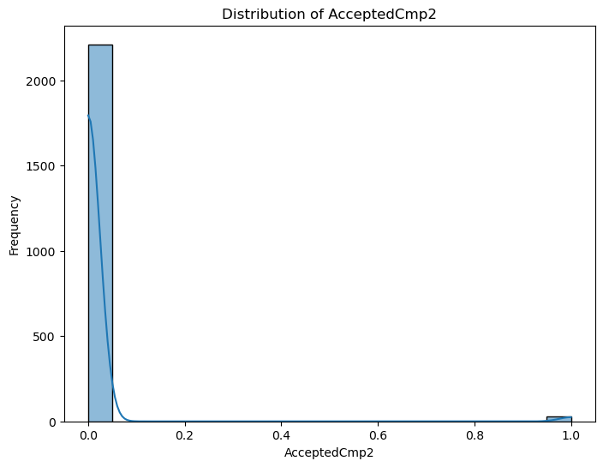
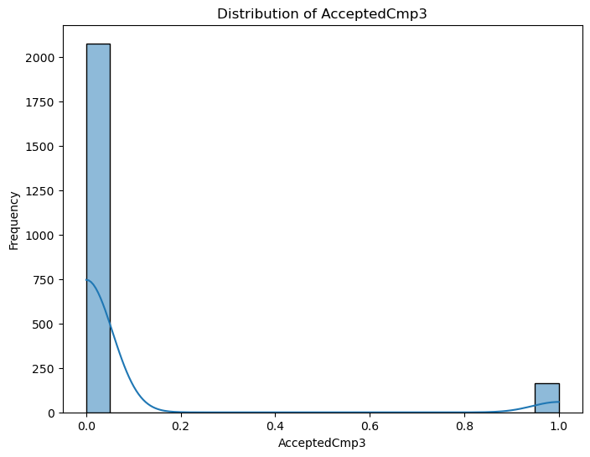


Slide 12

It can be observed that most of the customers are not accepting the offer when they were contacted during the campaign.
This shows that there is a need to change the nature of the campaign, so that people could accept the offer.
It is also observed that very handful of people are still accepting the order when they were contacted at the 5th campaign as well. Which means resources could be better utilized such that people accept the offer at minimum attempts.

Slide 13
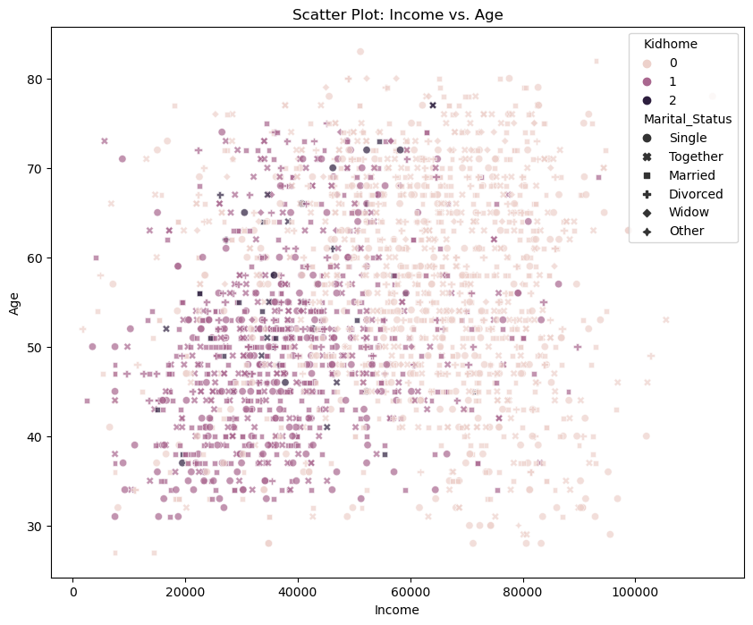
As, customer’s income increases to above $60000 and their age increases above 60 years, we could observe that those people have more of 0 kids at home.
Which means, that those customer wouldn’t require kids product from the company. So, we could alter the marketing campaign for them with less kids products.

Slide 14
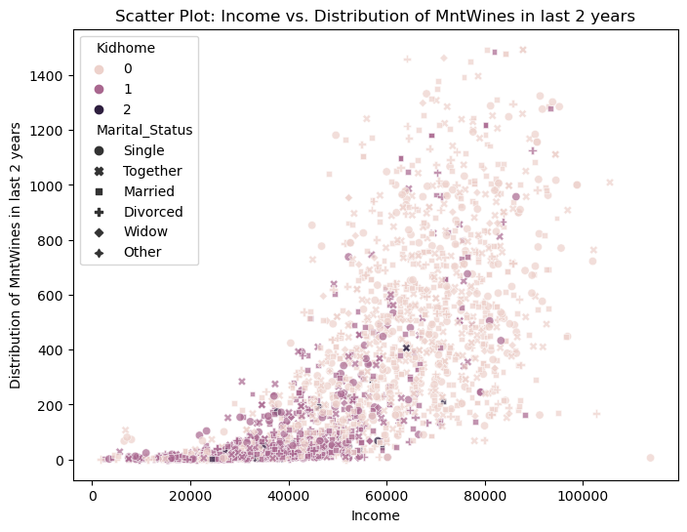
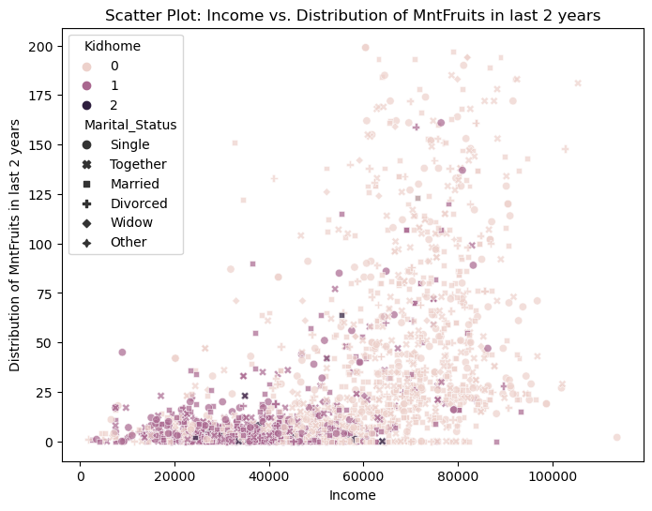
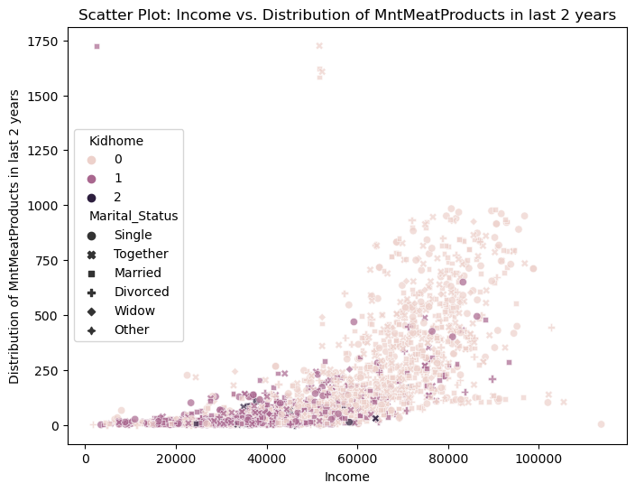
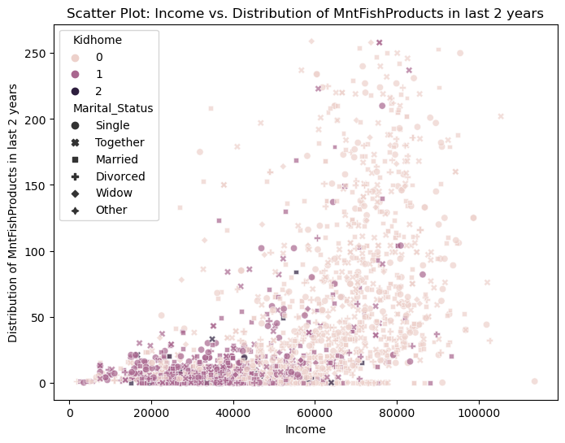

Slide 15
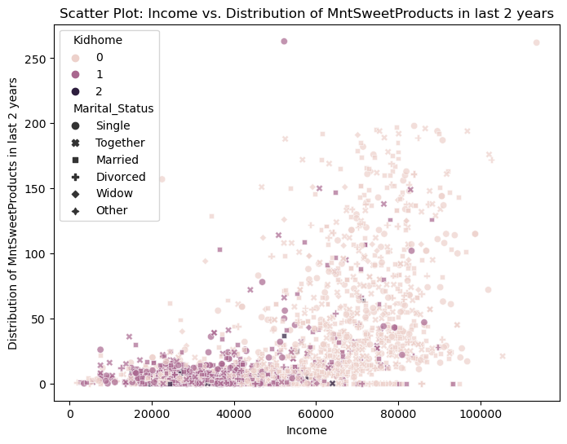
As income increase above $60,000, the expense on wines increases sharply by the customer with 0 kids at home. The expense on wines goes to around $1450 as well.
Similar trend is observed on the expense on fruits as well, but in case of fruits, customer spending is limited to around $ 175 in last 2 years.
Similar trend is observed on the expense on meat as well, but in case of meat, customer spending is goes till around $1000 in last 2 years.
Similar trend is observed on the expense on fish as well, but in case of fish, customer spending is limited to around $250 in last 2 years.

Slide 16
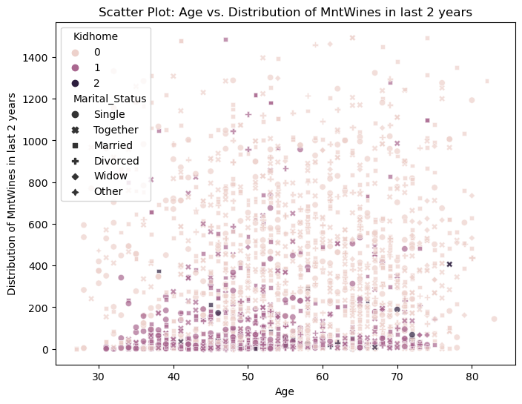
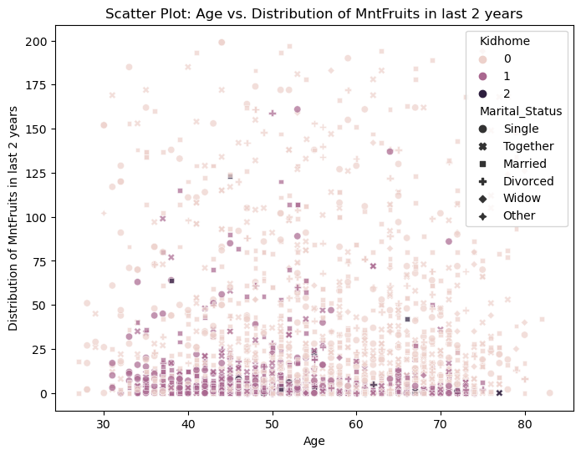
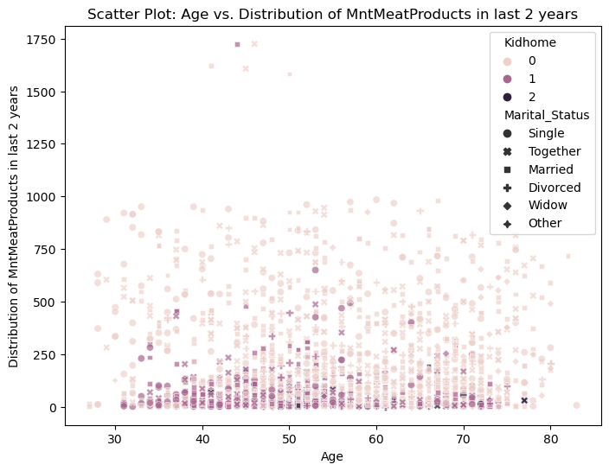
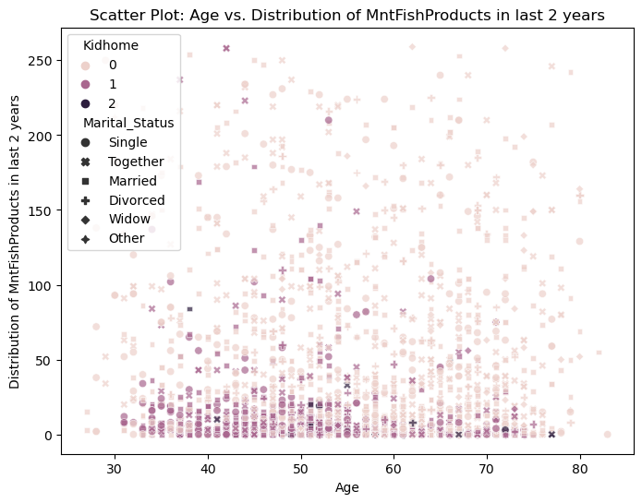

Slide 17
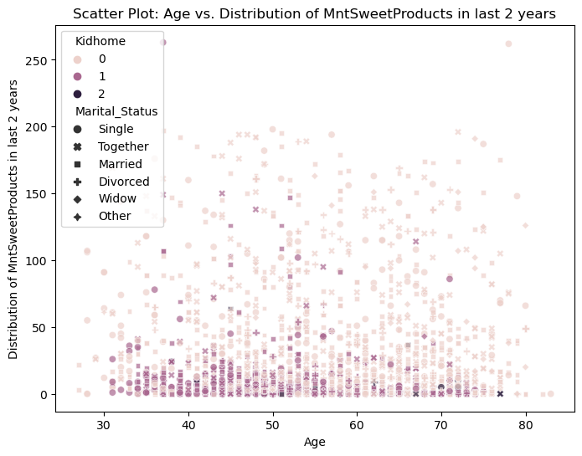
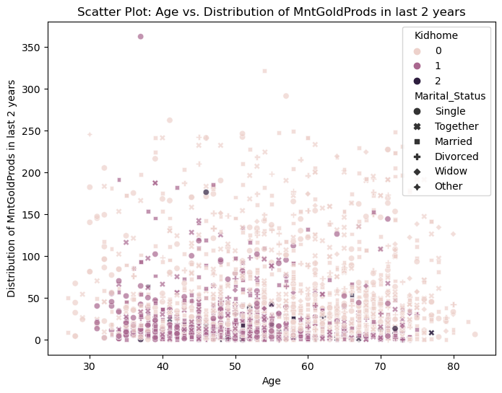
There seems to be not much variation in terms of age, when it comes to purchasing of wines and also all other product . As, customers across all the ages are purchasing them.

Slide 18
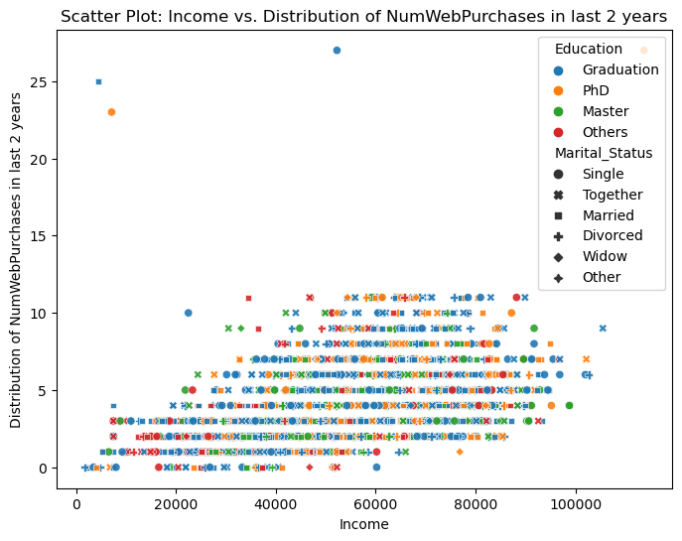
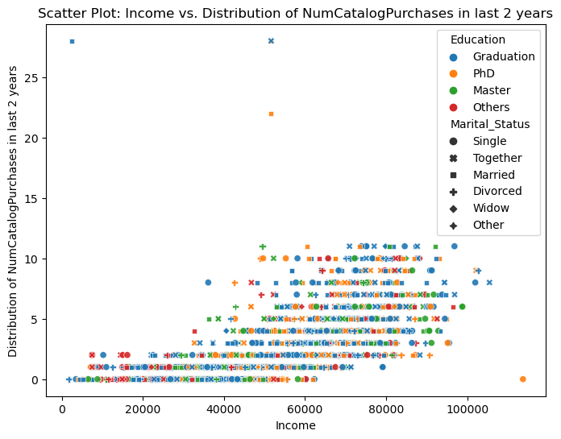
As the income increases, the number of web purchases also increases. But, the frequency is limited to around 10 times only.
As the income increases, again the purchases from the catalog purchases also increases bit sharply, with frequency limited to around 10-13 times.

Slide 19
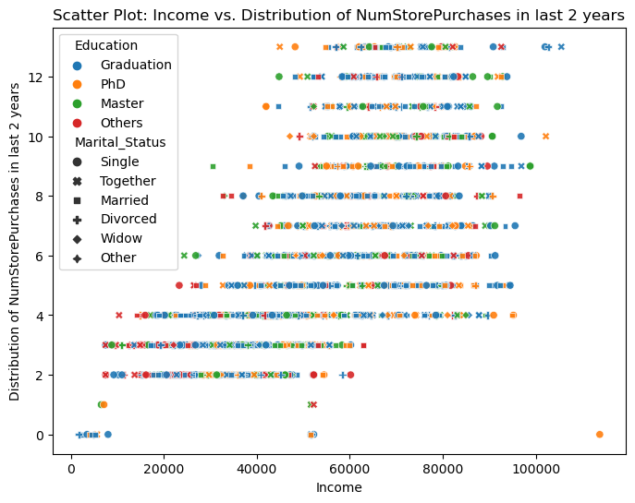
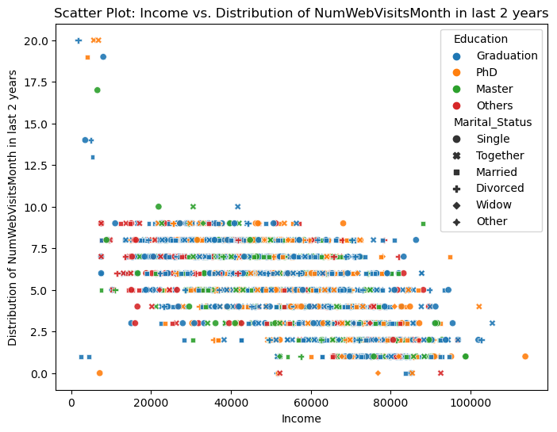
As income increases above $40000, there seems to be increase in the frequency of purchases from stores, which becomes nearly for all the income people above $40000.
As the income increases, there seem to trend of slightly decrease in the number of web visits per month by the customer. Which suggests that as income increase people purchase more from stores.

Slide 20
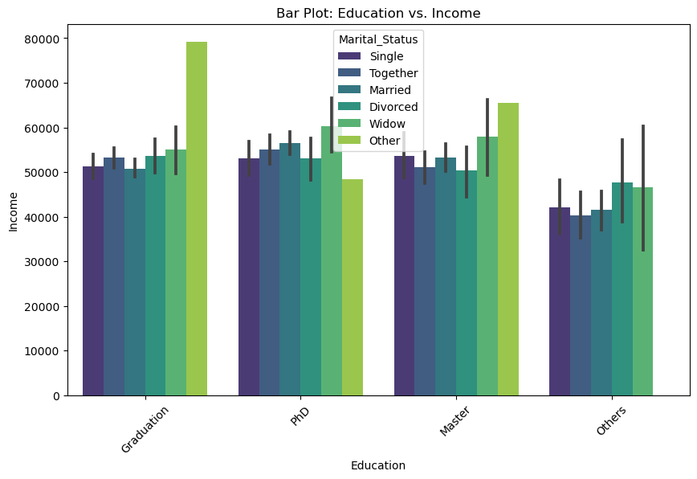
The customer with graduation, PhD and Master have more or less similiar income range. Hence, Customers can not be differentiated during marketing campaign based on their education.

Slide 21
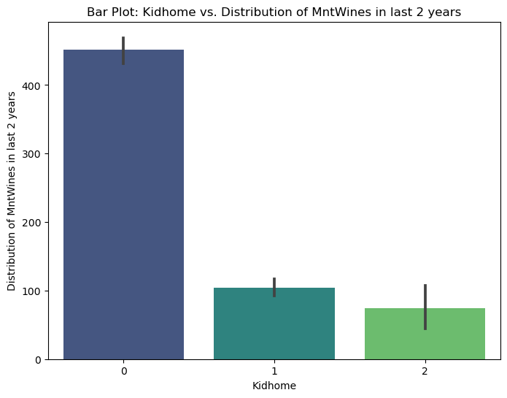
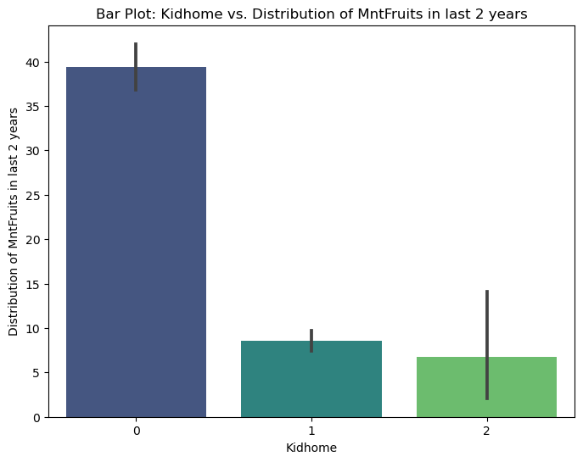
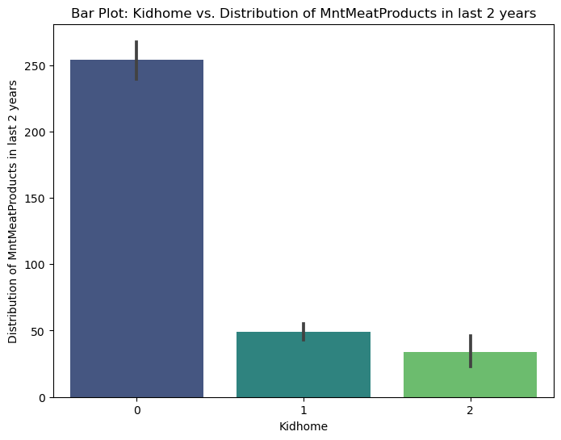
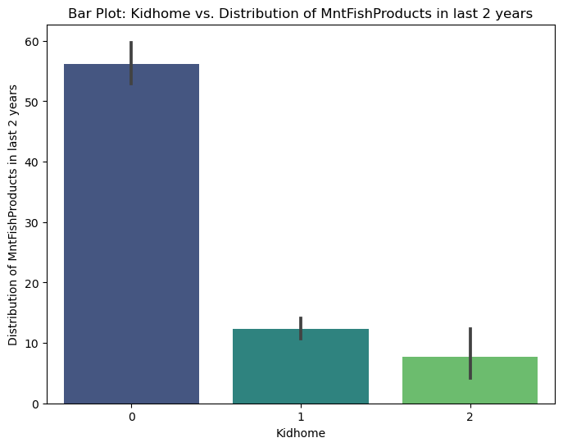

Slide 22
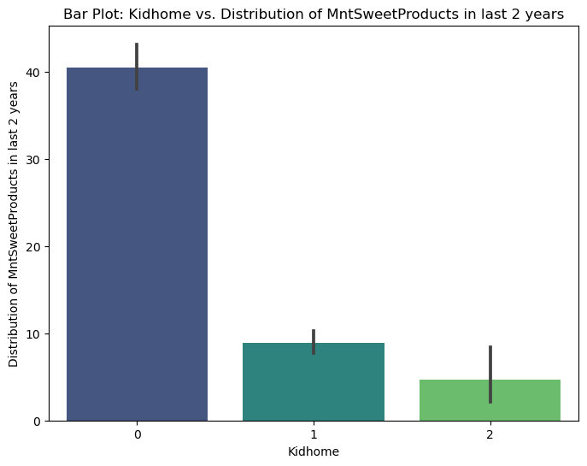
Clearly, Customers with 0 kid at home have higher probability of purchasing the products, irrespective of the nature of the item. Which seems to be contradicting as number of kids increases in home, customer purchasing power should also increase, which is not the case here. May be the item which kids require is not available at the company’s store or website. Hence, Kids items should also be included in the marketing campaign, as it may increase the purchasing power of the customers.

Slide 23
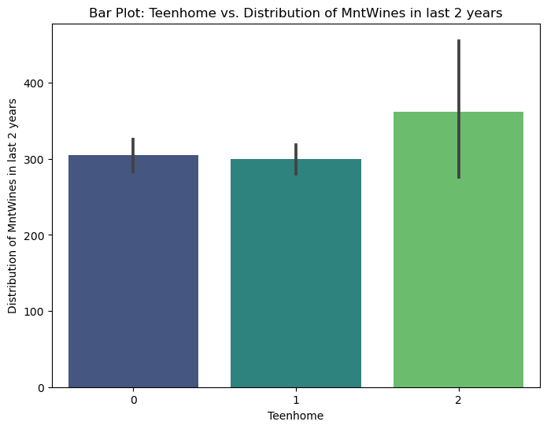
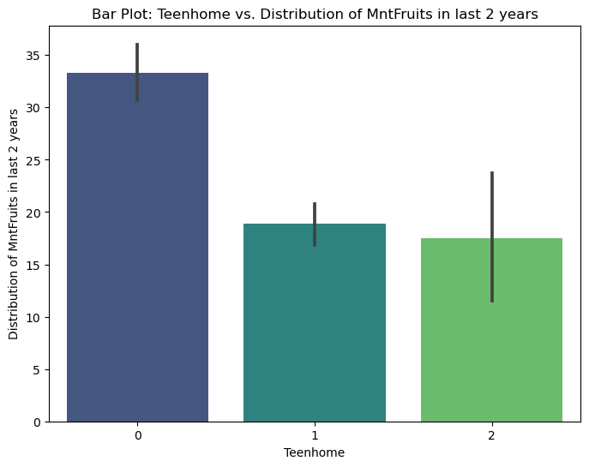
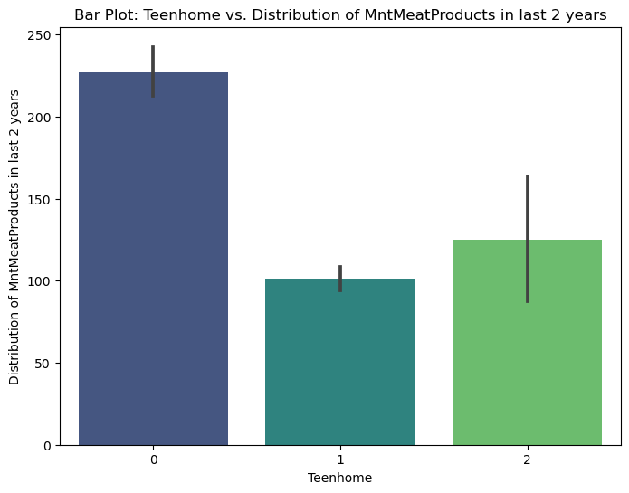
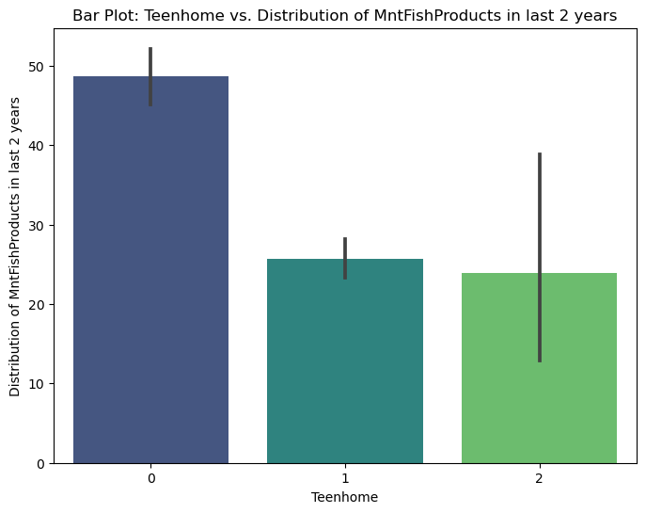

Slide 24
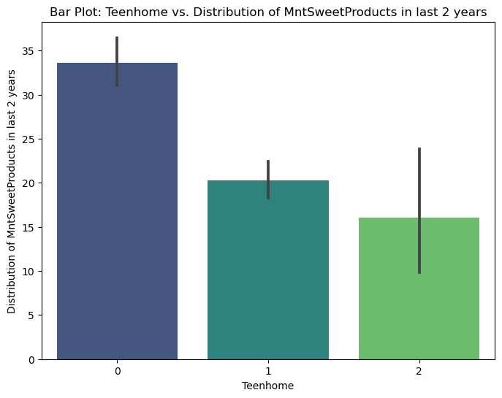
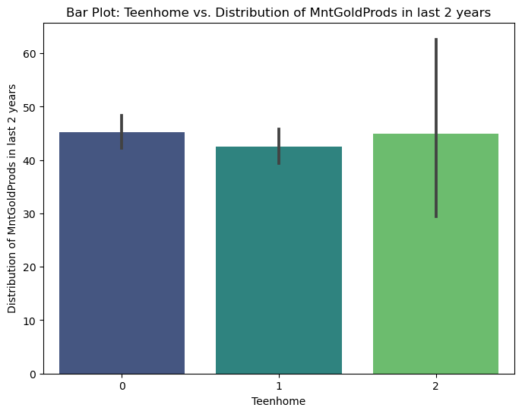
Amount spent on wine in last 2 years from customers who have 2 teen at home is more than 0 and 1 teen at home. This shows, with more people at home, there is increase in the amount spent on wines.
Amount spent on fruits in last 2 years from customers who have 0 teen at home is more than 0 and 2 teen at home. This shows, that customers with no teen at home, might be having kids and for them more amount is spent on fruits than wines.
Amount spent on meat, fish and sweet by the customers shows similar trend with 0 teen at home spending more on the meat and fish then 1 and 2 teens at home.
Amount spent on gold in last 2 years by the customers is almost same irrespective of the number of teens at home. This shows, that purchase gold products are not directly affected by the number of teens at home.

Slide 25
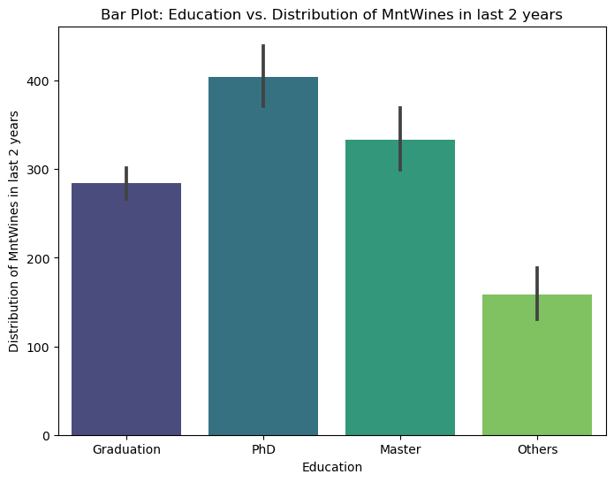
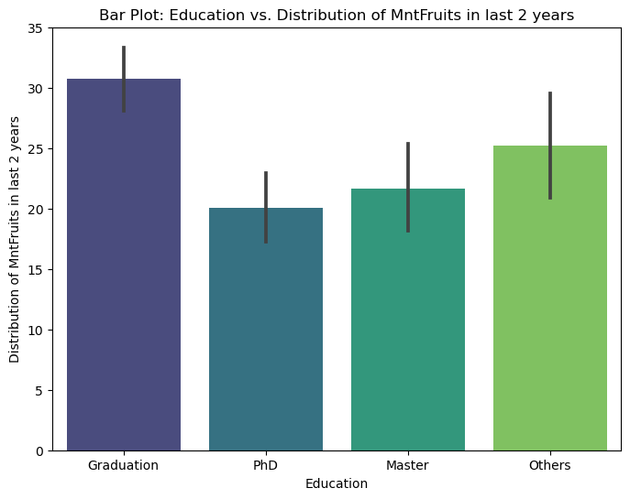
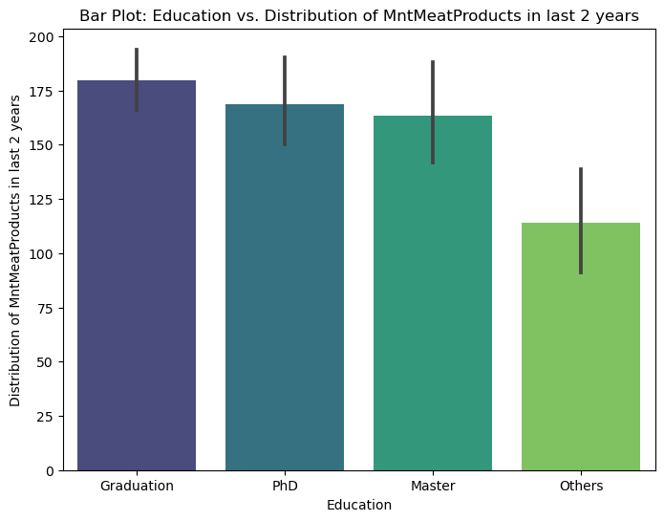
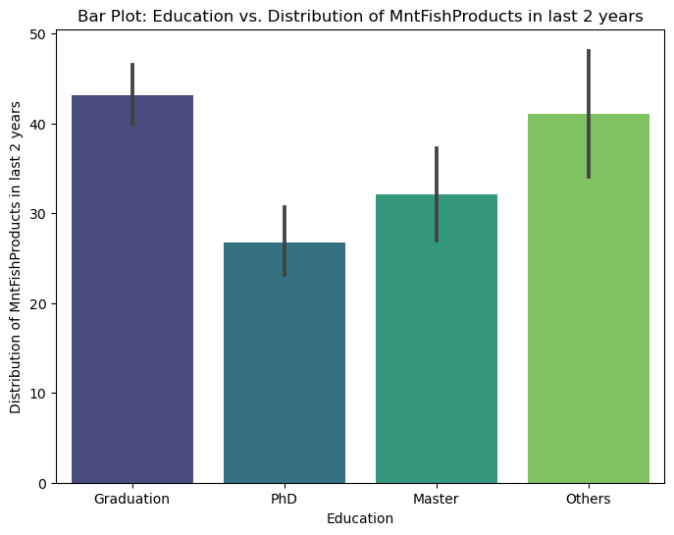

Slide 26
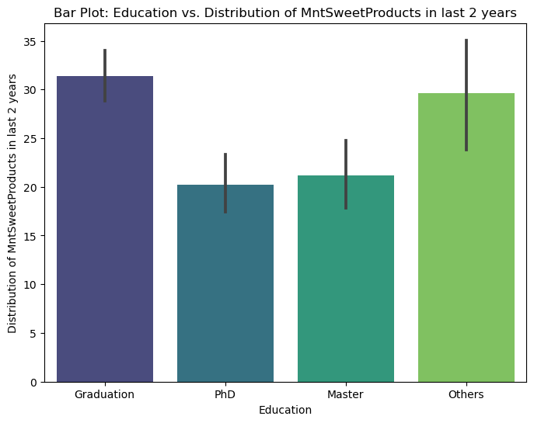

PhD scholars are spending most on wines than customers with any other education level, hence PhD scholars could be targeted more for wines.
Graduation students are the spending highest in the fruits than any customer with any other education level.
For meat product, there is no much difference on the amount of spending by the customers of different education level. So, meat the product which all types of customers are purchasing.
For Sweets and gold, again customers with graduation degree are purchasing more that any other customers.

Slide 27





Slide 28


Widow are spending more on wines than any other marital status.
While there is no much difference on spending by different marital status on fruits, meat ,fish and gold products.
For sweets, again widow are spending more.

Slide 29





Slide 30


Number of purchases made with a discount is equal among customers with different educational level.. Hence, all customers are willing to buy products when offered them wit discount.
Customers with graduation level of education are purchasing more at first campaign. Which means they are easier to convince for purchasing of goods.
The purchasing of goods at different campaign numbers varies with different educational level.
At 5th campaign, there seems that all customers have almost equal response of purchasing the products. Hence, all customers must be targeted with equal importance even at last number of campaign.

Slide 31


Slide 32

Insights:
We will use k = 4, thus there will be four clusters in our dataset.
We will use KMeans Algorithm for clustering.

Slide 33


Slide 34

Insights:
Cluster 0 has the highest amount of 603customers.
Cluster 1 has 511 customers.
Cluster 2 has 582 customers.
Cluster 3 has 540 customers.

Slide 35

Insights:
Most of the cluster 0 customers income range is in between 5000 to 40000 and spending range is in between 0 to 500.
Most of the cluster 1 customers income range is in between 65000 to 85000 and spending range is in between 550 to 2000.
Most of the cluster 2 customers income range is in between 50000 to 80000 and spending range is in between 250 to 1800.
Most of the cluster 3 customers income range is in between 40000 to 60000 and spending range is in between 0 to 500.

Slide 36

Insights:
Most of the cluster 0 customers spending range is in between 0 to 500.
Most of the cluster 1 customers spending range is in between 550 to 2000.
Most of the cluster 2 customers spending range is in between 250 to 500.
Most of the cluster 3 customers spending range is in between 520 to 2000.

Slide 37

Insights:
560 customers of cluster 0, 282 customers of cluster 1, 531 customers of cluster 2 and 411 customers of cluster 3 have not accepted any promotions yet.
52 customers of cluster 0, 125 customers of cluster 1, 47 customers of cluster 2 and 100 customers of cluster 3 have accepted only one promotions yet.
1 customer of cluster 0, 56 customers of cluster 1, 4 customers of cluster 2 and 22 customers of cluster 3 have accepted two promotions.
Only 37customers of cluster 1 and 7 customers of cluster 3 have accepted three promotions.
Only 11 customers of cluster 1 have accepted Four promotions.

Slide 38

Insights:
Most of the customers of cluster 0 have completed purchases using discount 1 times.
Most of the customers of cluster 1 have completed purchases using discount either 1/2 times.
Most of the customers of cluster 2 have completed purchases using discount 2 to 5 times.
Most of the customers of cluster 3 have completed purchases using discount 1 to 4 times.

Slide 39

Insights:
Customers of cluster 0 either have one child or don't have any. Their spending range is in between 0 to 500.
Most of the customers of cluster 1 don't have any child, only a few have one. Their spending range is in between 550 to 2000.
Most of the customers of cluster 2 have one child, some have two. Their spending range is in between 250 to 1800.
Most of the customers of cluster 3 have two child, some have one and very few have three. Their spending range is in between 0 to 500.

Slide 40

Insights:
The customers of cluster 0 are graduate or in postgraduate level or in undergraduate level. Their spending range is in between 0 to 500.
Most of the customers of cluster 1 are graduate or in postgraduate level. Their spending range is in between 550 to 2000.
Most of the customers of cluster 2 are graduate and very few in postgraduate level. Their spending range is in between 250 to 1800.
All the customers of cluster 3 are graduate or in postgraduate level and some are in undergraduate level. Their spending range is in between 0 to 500.

Slide 41

Insights:
Most of the customers of cluster 0 have age range in between 25 to 50. Their spending range is in between 0 to 500.
Most of the customers of cluster 1 have age range in between 30 to 60. Their spending range is in between 550 to 2000.
Most of the customers of cluster 2 have age range in between 35 to 60. Their spending range is in between 250 to 1800.
Most of the customers of cluster 3 have age range in between 40 to 65. Their spending range is in between 0 to 500.

Slide 42

Insights:
Most of the customers of cluster 0 are married and very few are unmarried. Their spending range is in between 0 to 500.
Most of the customers of cluster 1 are married. Their spending range is in between 550 to 2000.
Most of the customers of cluster 2 are married. Their spending range is in between 250 to 1800.
Some customers of cluster 3 are married and some are unmarried. Their spending range is in between 0 to 500.

Slide 43

Insights:
Most of the customers of cluster 0 are parents and very few are not parents. Their spending range is in between 0 to 500.
All the customers of cluster 1 are not parents. Their spending range is in between 550 to 2000.
All the customers of cluster 2 are parents. Their spending range is in between 250 to 1800.
All the customers of cluster 3 are parents. Their spending range is in between 0 to 500.

Slide 44

Insights:
Most of the customers of cluster 0 are customer for 300 to 900 days. Their spending range is in between 0 to 500.
Most of the customers of cluster 1 are customer for 250 to 750 days. Their spending range is in between 550 to 2000.
Most of the customers of cluster 2 are customer for 400 to 800 days. Their spending range is in between 250 to 1800.
Most of the customers of cluster 3 are customer for 150 to 650 days. Their spending range is in between 0 to 500.

Slide 45
Customer's Cluster Profiling
Cluster 0
Income range is in between 5000 to 40000 and spending range is in between 0 to 500.
Age range in between 25 to 50.
From any educational level
Can be married and unmarried as well
Most of them are parents
Some have one child
Customer for at least 300 days
Promotion acceptance is rare
Very few complete purchases using discounts

Slide 46
Cluster 1
Income range is in between 65000 to 85000 and spending range is in between 550 to 2000.
Age range in between 30 to 60
Almost all have completed graduation.
Most of them are married.
They are not parents.
Have no child.
Customer for at least 250 days.
Promotion acceptance ratio is 0.5.
Completing purchases using discounts are rare

Slide 47
Cluster 2
Income range is in between 50000 to 80000 and spending range is in between 250 to 1800.
Age range in between 35 to 60.
Almost all have completed graduation.
Most of them are married.
They are parents.
All have children, most have one child.
Customer for at least 400 days.
Promotion acceptance ratio is poor.
Highly interested in completing purchases using discounts

Slide 48
Cluster 3
Income range is in between 40000 to 60000 and spending range is in between 0 to 500.
Age range in between 40 to 65.
Almost all have completed graduation.
Can be married and unmarried as well.
They are parents.
All have children, most have two children.
Customer for at least 150 days.
Promotion acceptance is rare.
Highly interested in completing purchases using discounts

Slide 49
Model Building
Decision Tree
Random Forest
Gradient Boosting
Naive Bayes
K-Nearest Neighbors
SVM

Slide 50

1) Decision Tree

Slide 51


Slide 52

2) Random Forest

Slide 53

3) Gradient Boosting

Slide 54


4) Naive Bayes

Slide 55

5) K-Nearest Neighbors

Slide 56



6) SVM

Slide 57

Model Evaluation

Slide 58




Slide 59
Conclusion
Kappa score is high for Random Forest and least for SVM.
F1 score is Decision Tree, Random Forest and Gradient Boosting.
Recall is also high for Decision Tree, Random Forest and Gradient Boosting.
Precision is high for Decision Tree and Random Forest.
Accuracy is also high for Decision Tree, Random Forest and Gradient Boosting.
So, overall Random Forest is preferred over other methods.

Slide 60

Model Deployment

Slide 61

Deployment using Streamlit

Slide 62


Challenges
Data Cleaning and Preprocessing:
Problem: Incomplete or messy data.
Resolution: Use data cleaning techniques to handle missing values, outliers, and inconsistencies.

Slide 63


Outliers

Slide 64



Slide 65

2) Feature Engineering:
Problem: Selecting the right features or variables to analyze can be challenging.
Resolution: Explore different feature selection techniques, such as correlation analysis and recursive feature elimination.

Slide 66

Data Transformation

Slide 67


Slide 68


3) Data Exploration and Visualization:
Problem: Choosing the Right Visualization
Resolution: Selecting the appropriate visualization method for your data can be challenging. Different data types (categorical, numerical, time series, etc.) require different types of visualizations
Categorical Data:
Bar Charts: Bar charts are excellent for displaying the frequency or count of different categories. They're commonly used for visualizing categorical data.
Pie Charts: Pie charts show the composition of a whole based on the proportions of different categories. They are suitable for displaying parts of a whole.

Slide 69
Numerical Data:
Histograms: Histograms show the distribution of numerical data. They're useful for visualizing data spread and identifying patterns.
Box Plots: Box plots provide a summary of the distribution of numerical data, including median, quartiles, and potential outliers.
Scatter Plots: Scatter plots help visualize relationships between two numerical variables. They're useful for identifying correlations and trends.

Slide 70


4) Data Imbalance:
Problem: Imbalanced classes in the target variable can affect model performance.
Resolution: Using data standarisation. Standardization transforms data to have a mean of 0 and a standard deviation of 1. This means that all features (variables) have the same scale, which can be important for certain algorithms

Slide 71


5) Numerous Dimensional Data:
Problem: As there are more than 10 dimension so difficult for doing model building.
Resolution: Reducing dimensions through Principal Component Analysis (PCA) technique.

Slide 72


5) Clustering
Problem: For grouping people with reference to their personality, how many clusters need to from.
Resolution: For getting adequate number of cluster we used elbow method which gives desired number of clusters.

Slide 73
6) Model Selection:
Problem: Choosing the right machine learning or statistical model is challenging.
Resolution: Experiment with different models (e.g., decision trees, random forests, logistic regression) and use techniques like cross-validation to assess their performance.

Slide 75
6) Model Deployment:

Slide 76


Slide 78
Thankyou

